Slide 1
Ohm’s Law

Slide 2

By the end of this lesson you will be able to:
Describe Ohm's law.
Solve problems using Ohm's law.
Interpret graphical representations to determine the resistance of an object.
Compare and contrast ohmic and non-ohmic resistors.

Slide 3
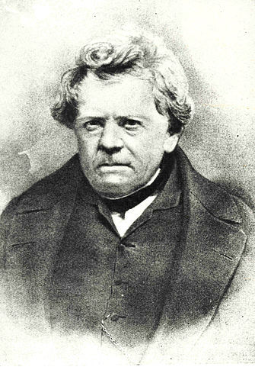
But first, who was Ohm?
Georg Ohm was a German physicist who first discovered the relationship between current, potential difference and resistance. Ohm summarised his new law in a pamphlet he published in 1827.
Unfortunately, it took a while for his work to be fully appreciated. It wasn’t until 1841 that the Royal Society in London honoured his work by awarding Ohm the Copley Medal. By the time he died, Ohm’s law had become widely accepted. You may also recognise Ohm’s name as the unit for measuring electrical resistance (given by the symbol Ω).

Slide 4
There is an extremely important relationship in electricity that we call Ohm's Law.
Ohm's Law links the current, the resistance and the potential difference (voltage) of a circuit together. It's an incredibly useful tool for anyone who needs to do calculations involving circuits.
Ohm's Law states that the potential difference of a circuit is directly proportional to the current of the circuit and its resistance.
The relationship between current (I), potential difference (V) and resistance (R) can be expressed as:
V=IR

Slide 5

A directly proportional relationship means that changes that happen to one variable will happen to the other.
So what Ohm's Law states is that increasing the potential difference will increase the current, and decreasing the current will decrease the potential difference.
Potential difference is also directly proportional to resistance. A high potential difference is caused by a high resistance, and a low potential difference is caused by a low resistance (for the same value of current).

Slide 6
The final step here is that current is inversely proportional to resistance.
An inversely proportional relationship means that if one value decreases, the other will increase. If the resistance is increased, the current will decrease, and higher currents occur when resistance is smaller.
It is difficult to predict change if all three values are changing. This is why we usually make sure one value is kept constant. The constant (unchanging) value for Ohm's Law is usually resistance. Resistance only changes if the circuit itself is altered, so most calculations have a constant resistance. If we change the resistance, the potential difference will be constant, because this depends on the power supply. It is difficult to keep a constant current.

Slide 7
Let’s take another look at that important equation.
V=IR
This means that potential difference (V) is equal to current (I) multiplied by resistance (R). It is the most important formula in the study of electricity!
Have a go at trying to rearrange this equation to make current or resistance the subject.

Slide 8
The formula needs to be rearranged depending on what information we need to calculate.
We can rearrange this formula to find the current in part or all of a circuit:
I=V/R
We can also use it to find the resistance of the circuit or one of its components:
R=V/I

Slide 9
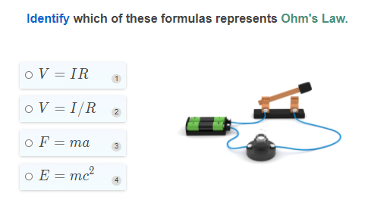

Slide 10
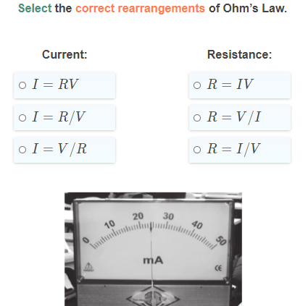

Slide 11
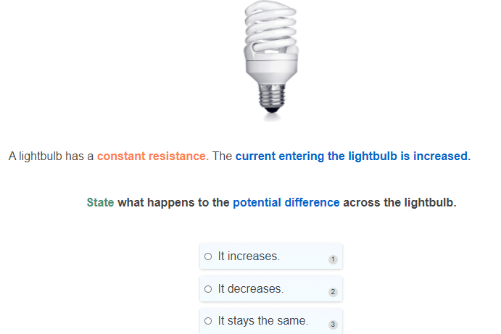

Slide 12


Slide 13
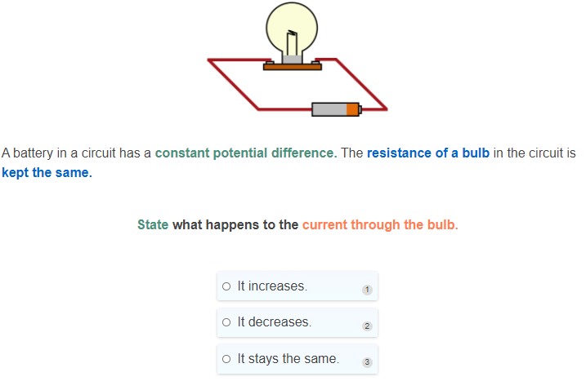

Slide 14
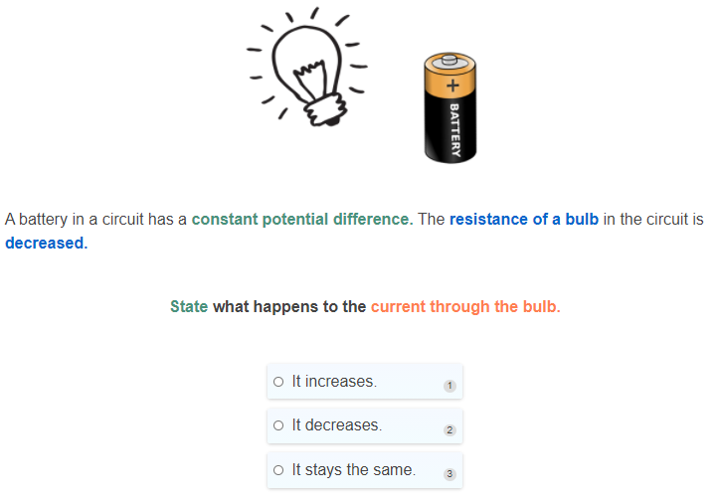

Slide 15
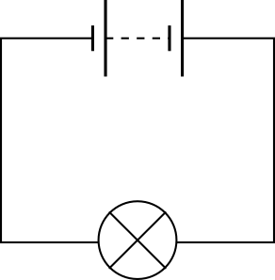
Calculating Potential Difference.
Let's work through an example! Say you have a lightbulb that has a resistance of 10Ω (10 Ohms). The current travelling through the lightbulb is 1A (1 Amp).
Calculate the potential difference across the lightbulb.

Slide 16
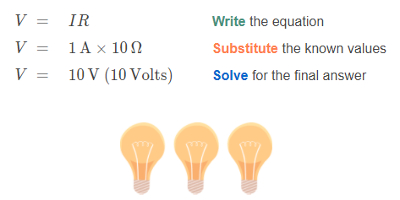
Calculating Potential Difference: Solution.
A lightbulb has a resistance of 10Ω. The current travelling through the lightbulb is 1A.
Calculate the potential difference across the lightbulb.
We can use Ohm’s law to solve for the potential difference across the lightbulb:

Slide 17
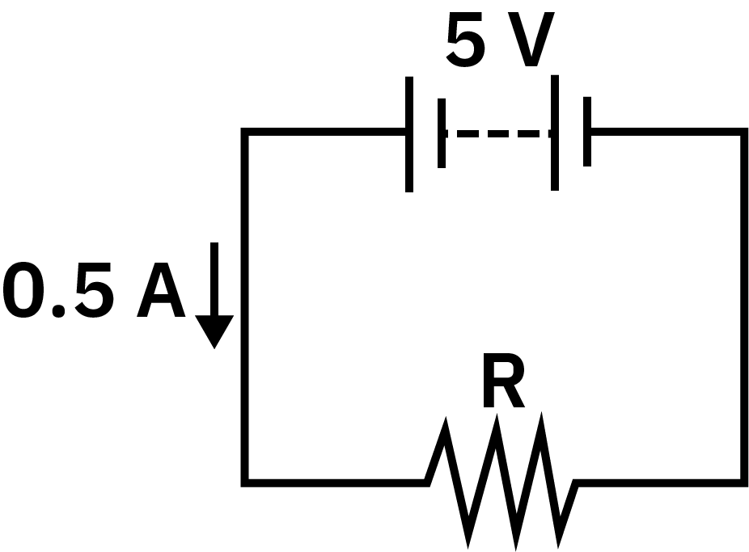
Calculating Resistance.
So what if you already know the potential difference and current? Time to put those rearranging skills to the test.
A circuit has a potential difference of 5V across it and the current travelling through the circuit is 0.5A.
Calculate the resistance of the circuit.

Slide 18
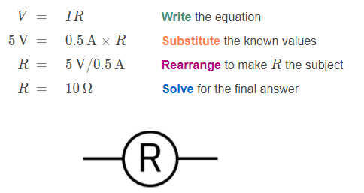
Calculating Resistance: Solution.
A circuit has a potential difference of 5V across it and the current travelling through the circuit is 0.5A.
Calculate the resistance of the circuit.

Slide 19
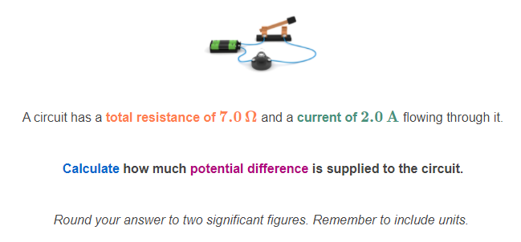

Slide 20
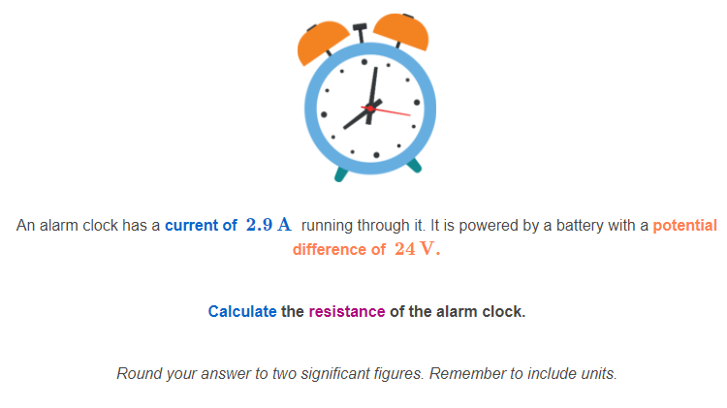

Slide 21
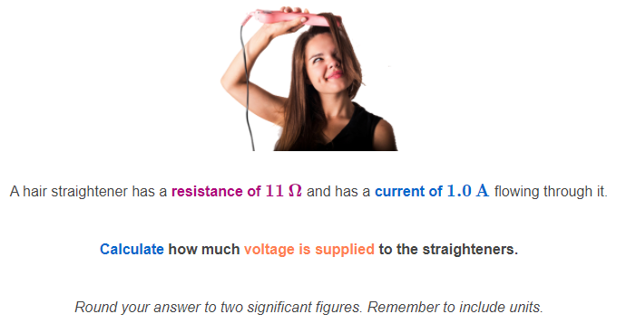

Slide 22
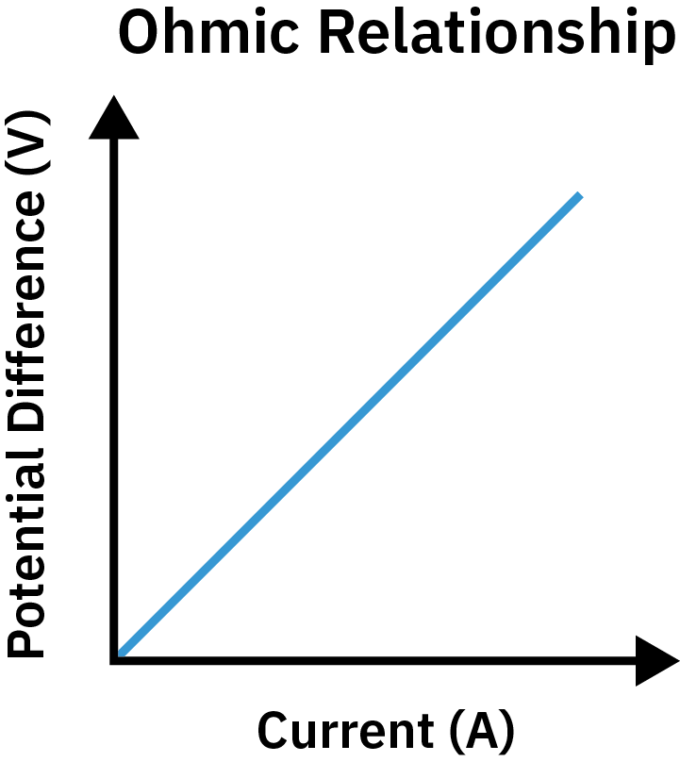
We classify conductors as ohmic or non-ohmic based on whether they satisfy Ohm's Law.
A conductor is a material that allows current to pass through it. All circuit components are made up of conductors.
Remember, Ohm's Law states that potential difference is equal to current multiplied by resistance. This means that, according to Ohm's Law, there is a linear relationship between potential difference and current.
We can graph the relationship between potential difference and current. When potential difference and current across a component satisfy Ohm's Law, the plot produces a straight line. The gradient of this straight line will tell us the resistance! If the gradient of the line does not change, this means the resistance does not change.

Slide 23
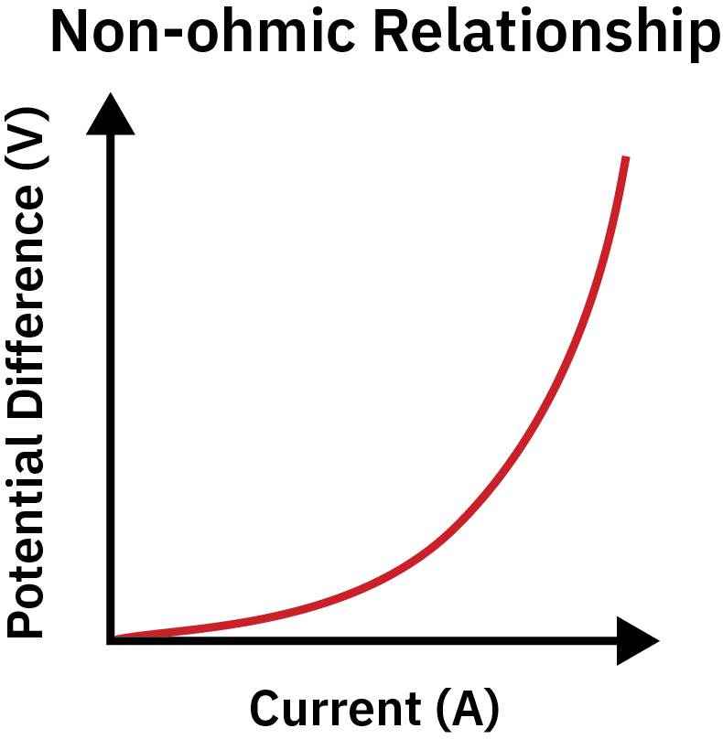
However, some circuit components do not satisfy Ohm's Law.
This means that the potential difference and current across the component have a non-linear relationship. One example of a non-linear relationship is shown below.
In a non-ohmic component, the relationship between potential difference and current changes as one of these factors changes. Therefore, the resistance of the component will also change. We can see this, as the gradient on the graph is not constant.

Slide 24
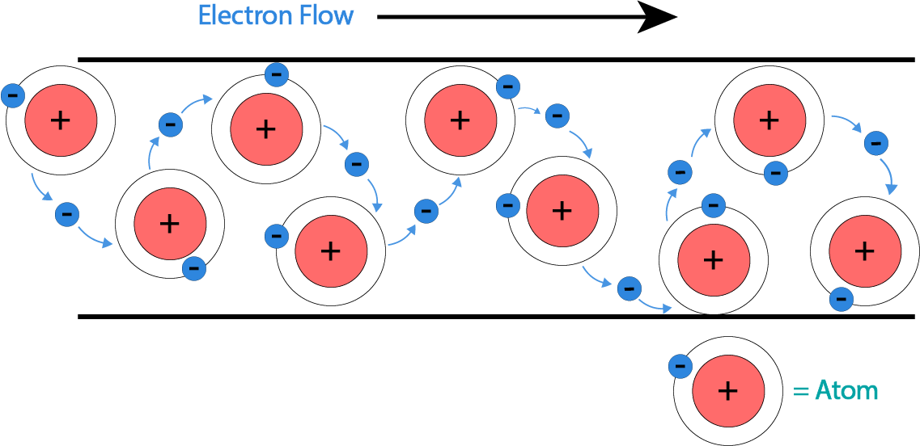
This strange phenomenon is due to the effect of temperature.
A current is a flow of electrons. As a current flows through a metal wire, it heats the wire. This causes metal ions in the wire to vibrate. The hotter the wire gets, the more the atoms vibrate.
Electrons interact with the metal ions as they flow through the wire. When the atoms vibrate faster, there are more interactions between the electrons and the atoms.
When the electrons interact with the metal atoms a lot, it takes longer for them to pass through a given section of wire. Therefore, heating the wire slows down the current. This means that the resistance of the wire must increase, causing a larger potential difference to take place across the section of wire.

Slide 25
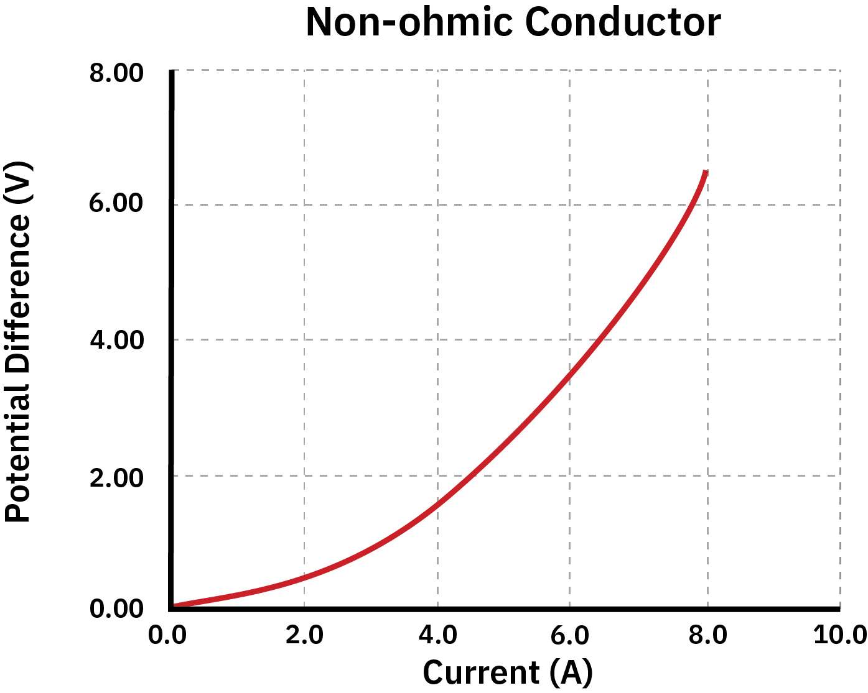
A lightbulb is a non-ohmic conductor.
There is a non-linear relationship between the potential difference across the lightbulb and the current that flows through it. This occurs because lightbulbs get very hot when current flows through them.
The potential difference-current graph for a lightbulb is given below. Notice that the graph gets steeper as the current increases. The resistance of the conductor is given by the gradient of the potential difference-current graph, so this confirms our expectation that the resistance of the lightbulb increases as the current increases.

Slide 26
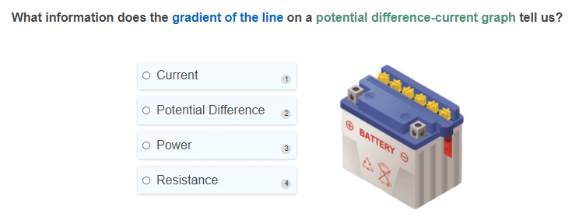

Slide 27
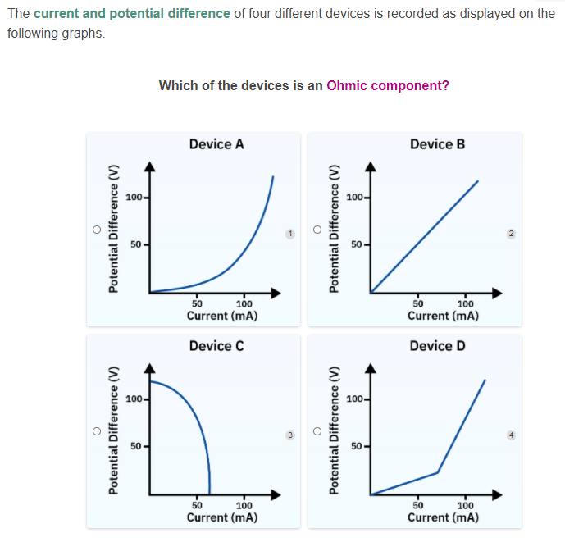

Slide 28
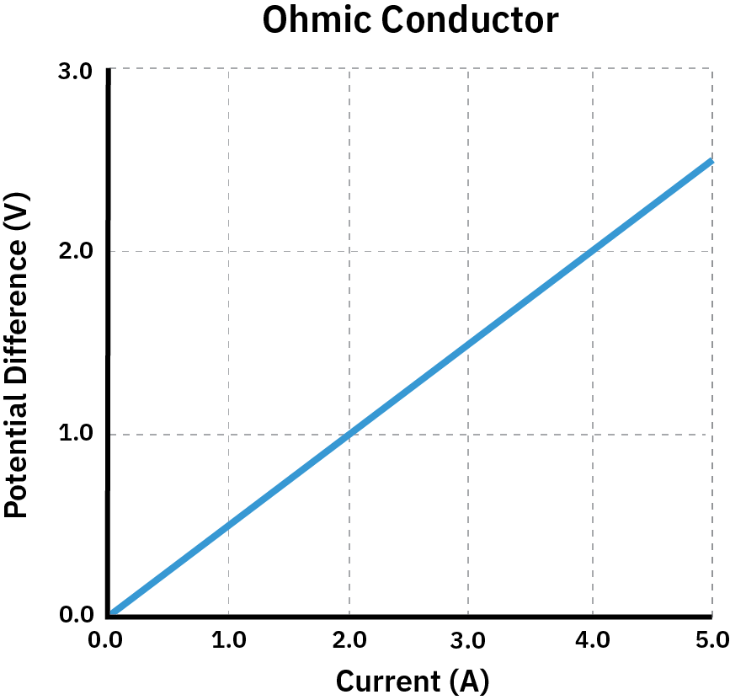
Now let’s take a closer look at the potential difference vs current graphs.
We may want to find the potential difference across an ohmic conductor at a certain current. To do this, we simply read the potential difference off the graph.
Take a look at the graph below. What is the potential difference across this conductor when a current of 4A flows through it?

Slide 29
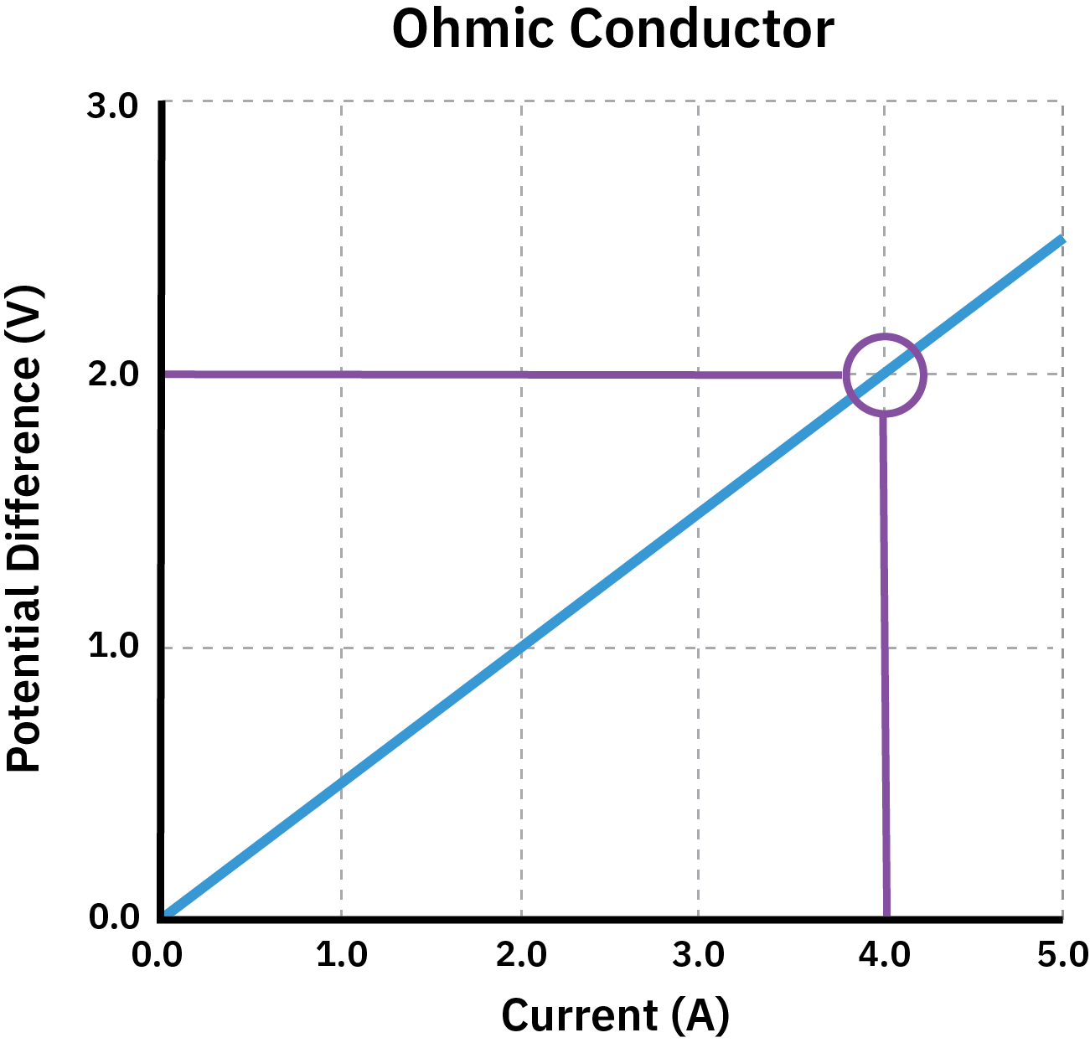
We can use the graph to find the potential difference if we know the current.
There is a potential difference of 2V when a current of 4A passes through the ohmic conductor.
We find this by tracing a line up from the 4A mark until it intersects the plot. We then trace a perpendicular line to the Y axis and read off the value at that point.

Slide 30
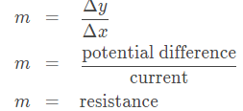
We may also want to find the resistance of the ohmic conductor.
Remember, the resistance of the conductor is given by the gradient of the potential difference-current graph. The gradient of a graph is given by the change in y over the change in x.
Since we plot potential difference on the y axis and current on the x axis, the gradient of the graph gives us the resistance of the circuit component. This comes from Ohm's Law, which states R=V/I.

Slide 31
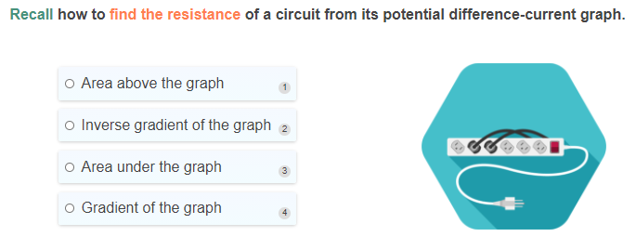

Slide 32
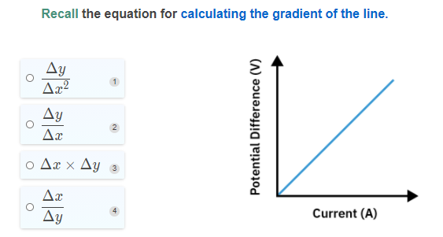

Slide 33
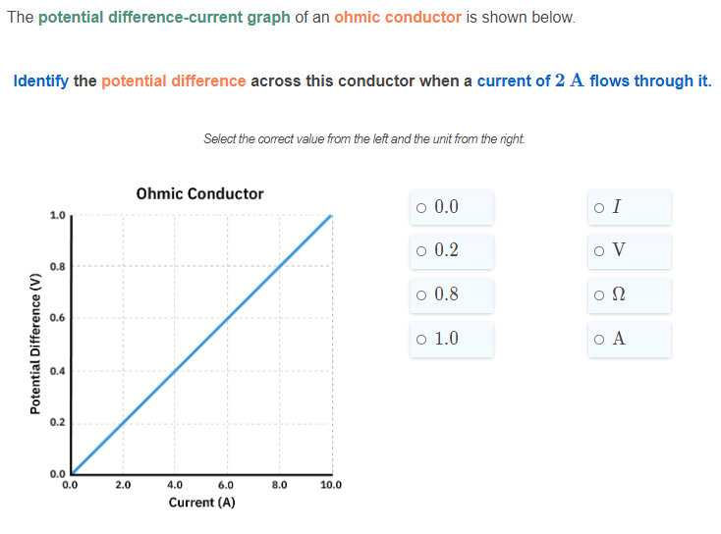

Slide 34
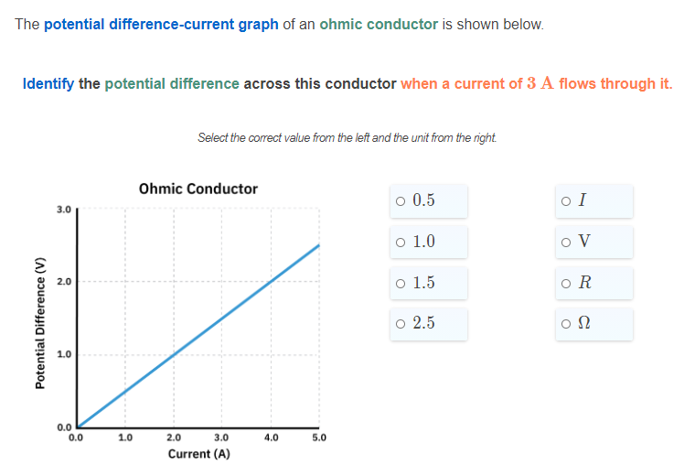

Slide 35
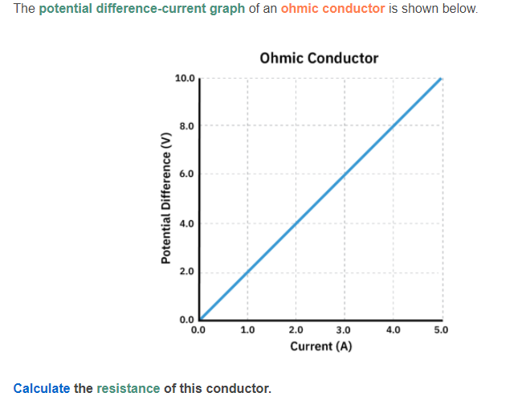

Slide 36
